Slide 1
IBM Presentation Template
Full Version
Presenter’s Name - Presenter’s Title
DD Month Year

Slide 2
Selecting a template
IBM Presentation Template Full Version
There are two versions of each template: a white background format and a black background format
While either may be used for any audience, the white is intended for print-based presentations, as it requires less ink per page and it allows for notes to be written on the white pages
For large audiences viewing the presentation from a distance, the black background can improve the legibility of the page content
Source: If applicable, describe source origin

Slide 3
Table of contents/Agenda template
IBM Presentation Template Full Version
Content heading 1
Content heading 2
Content heading 3
Content heading 4
Note that the contents/agenda items are written in sentence case
Title the page “Table of contents” if the document is meant to be read or is a “leave behind.” Use “Agenda” if the document will be presented formally
This page should appear at the beginning of each section, with the highlighted section appearing in blue and bold
Source: If applicable, describe source origin

Slide 4
There are five simple rules for creating impactful PowerPoint documents
IBM Presentation Template Full Version
Keep it simple, keep it clean, crisp, and clear
Make the title into an ‘Action title’: an active sentence that reveals an insight or suggests an action; it should never just be a description of the content
Do not use slides as an auto-cue
Be consistent with layouts, type sizes and diagrams
Do use, but do not always trust the “spell check” and review your presentation carefully
  Spell check can miss words out of context (e.g. from/form)
Source: If applicable, describe source origin

Slide 5
Title, 22 point Arial - IBM blue; it should never exceed two lines of text
IBM Presentation Template Full Version
The title should not be resized or moved
The title should always use lower case, other than the first letter
It should not have more than two lines
  When a title is two lines long, choose a division that is grammatically logical and aesthetically pleasing
    Ideally, the top line should be moderately longer than the lower line
    Avoid dividing articles from nouns, prepositions from prepositional phrases,
    verbs from nouns, etc.
The text above the title is called the “running header,” Arial 10pt. Regular
  This text is typically as used chapter titles, which makes it easy for the audience to follow where you are in the presentation
Source: If applicable, describe source origin

Slide 6
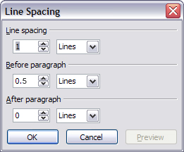
The bullets on the page should be clear and concise
IBM Presentation Template Full Version
Use the “Tab” key (or increase indent button) to obtain the proper indents and bullets
Use 16 point Arial body text as the minimum type size
The line spacing (see illustration) has been carefully chosen to introduce a balance between text and white space (1 Lines for line spacing, .5 Lines before paragraph spacing) and should be checked for consistency
  If you use indents (like this), please set paragraph spacing to 0 for the indented text by using Format > Line spacing…
On a white background, bulleted body text should appear in black and should be set in upper and lower case
Where required you can use indents as follows
  Second level
    Third level
    All bullets are black
    Do not go beyond three levels of indent
Source: If applicable, describe source origin

Slide 7
This template is set to US English throughout
IBM Presentation Template Full Version
To change the language settings:
  Make sure you are in normal view – View > Normal (from the command menu)
  Click anywhere in the text box
  Then select everything by using Edit > Select All or Ctrl A
  The language can now be set to your local language by using Tools > Language…,
  and selecting the language you require from the available languages
To create a local language version of this template, also set the language on the Slide Master, Title Master, Notes Master and Handout Master and save the file as a Document Template
  To make it appear as a standard template, save it to the location of your MS Office templates. This location varies according to the version of Windows used
Source: If applicable, describe source origin

Slide 8
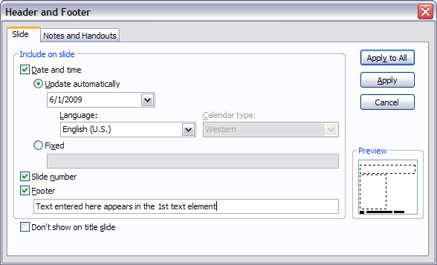
Footers
IBM Presentation Template Full Version
Footers can be used if necessary for dates, confidential material, etc.
The Footer text has the standard form <date> and <footer>
The contents of the fields <date> and <footer> can be set using the
View > Header and Footer command
There are four fixed elements on each page which should not be changed
  IBM Logo
  Horizontal rule
  Page number location
  IBM copyright statement
Source: If applicable, describe source origin

Slide 9
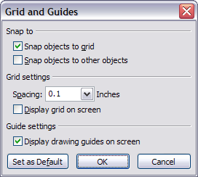
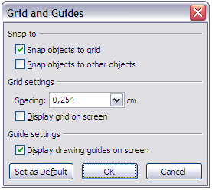
Basic alignment
IBM Presentation Template Full Version
This template has the Grid on as a default
Select snap objects to grid to align objects
Set to 0.1 inches or 0.254 cm
Use drawing guides to help align if needed
Grids help objects to be spaced evenly, aligned and consistent in size
First Box
A
Second Box
B
Third Box
C
Fourth Box
D
Fifth Box
E
Source: If applicable, describe source origin

Slide 10
Color palette
IBM Presentation Template Full Version
A color palette has been selected and keyed to basic elements such as Action title type in blue and basic text in black
Hyperlinks have been keyed to blue. Visited hyperlinks have been keyed to purple
There is also a palette for accent colors, including orange, aqua and yellow-green
  Other color selections can be made, but should be limited so that our presentations match consistently.
The color palettes have been built into the templates (numbers below refer to RGB values)
0
0
0
128
128
128
120
137
251
113
191
167
0
153
153
153
204
0
255
100
0
153
0
204
Source: If applicable, describe source origin

